Slide 1
Mid Term Presentation Team eXi

Slide 2








Agenda
Introduction
Demonstration
Technical Complexity
User Testing
Project Management
X Factor
Pilot Testing
Learning Outcomes

Slide 3
1.
Introduction

Slide 4
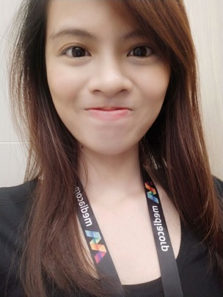

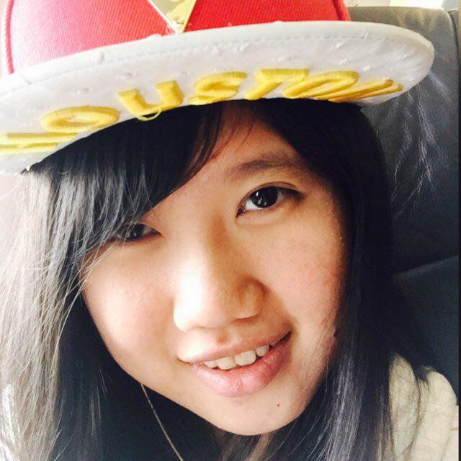
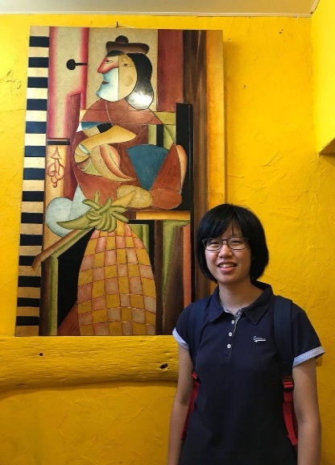

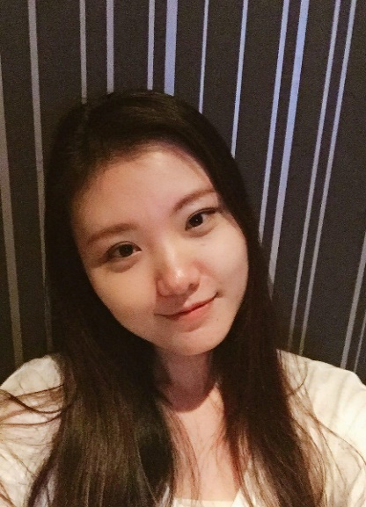
The Team

Slide 5



Project Overview
Integrated Web Application
To support operations of the Centre and administrative activities carried out
Facilitate the tracking of performances for parents and provide motivational incentives for students

Slide 6


Stakeholders
Sponsor
Mrs Lian Chee
Principal Instructor
Head, Education Outreach

Slide 7



Motivation
Education sector is a sector we all could relate to
Daily tasks could take up to several hours per day due to the Paper-Based System
Time reduced could be spent on more value adding tasks such as restructuring of curriculum

Slide 8
2.
Demonstration

Slide 9
3.
Technical Complexity

Slide 11
4.
User Testing

Slide 12
Objectives
Gather feedback regarding Interface Design and Navigation Flow
Gauge user’s comfortability & satisfaction with the UI and functionalities implemented
Improve the Portal based on feedbacks and comments received

Slide 13




User Testing 1
Account Module
Admin Module
Student Mgmt Module
Grades Module
Stepping Stones Learning Centre, Bukit Panjang Branch
28 July 2018, Saturday
2:30 pm – 3:30 pm
2

Slide 14
Issues
Trouble with navigating due to the naming of navigation bars

Slide 15
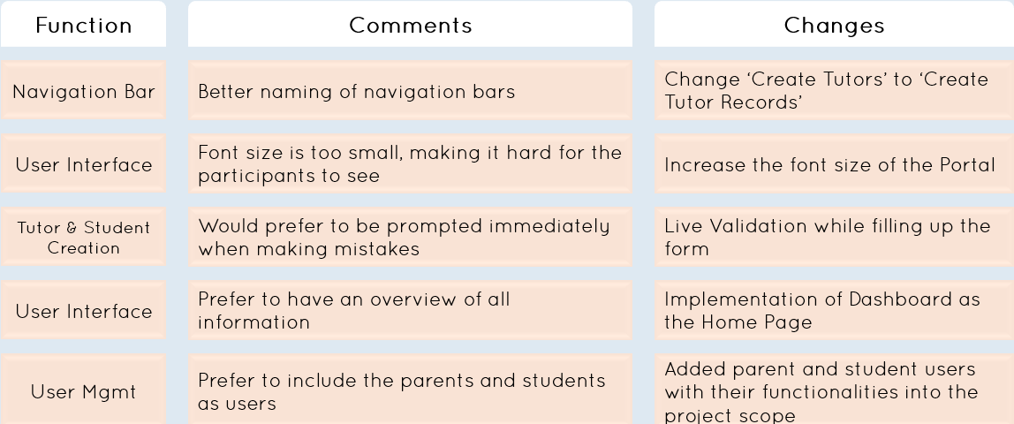
Overall Feedbacks

Slide 16
User Testing 2
Attendance Module
Grades Module
Schedule Module
Stepping Stones Learning Centre, Bukit Panjang Branch
8 September 2018, Saturday
2:30 pm – 3:30 pm
2

Slide 17
Issues
Layout of Attendance Taking Interface not intuitive enough
Confusing label specifying grade but input field is limited to raw score

Slide 18
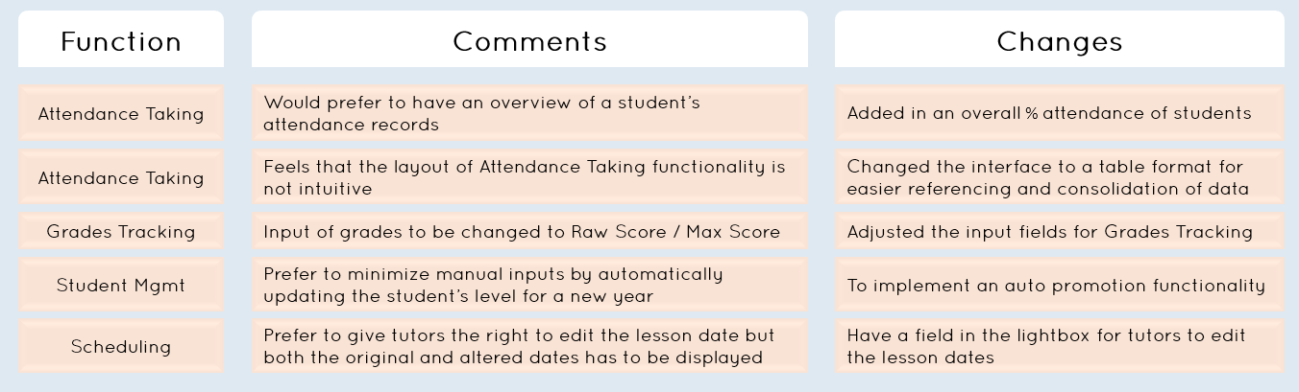
Overall Feedbacks

Slide 19
User Testing 3
Student Mgmt Module
Admin Module
Attendance Module
Grades Module
Schedule Module
Stepping Stones Learning Centre, Bukit Panjang Branch
22 September 2018, Saturday
2:30 pm – 5:00 pm
2

Slide 20
Issues
Confusion over what happens after the creation of Branch Admins
Could not remove multiple levels for Edit Subject at once
Unable to locate the editing functionalities

Slide 21
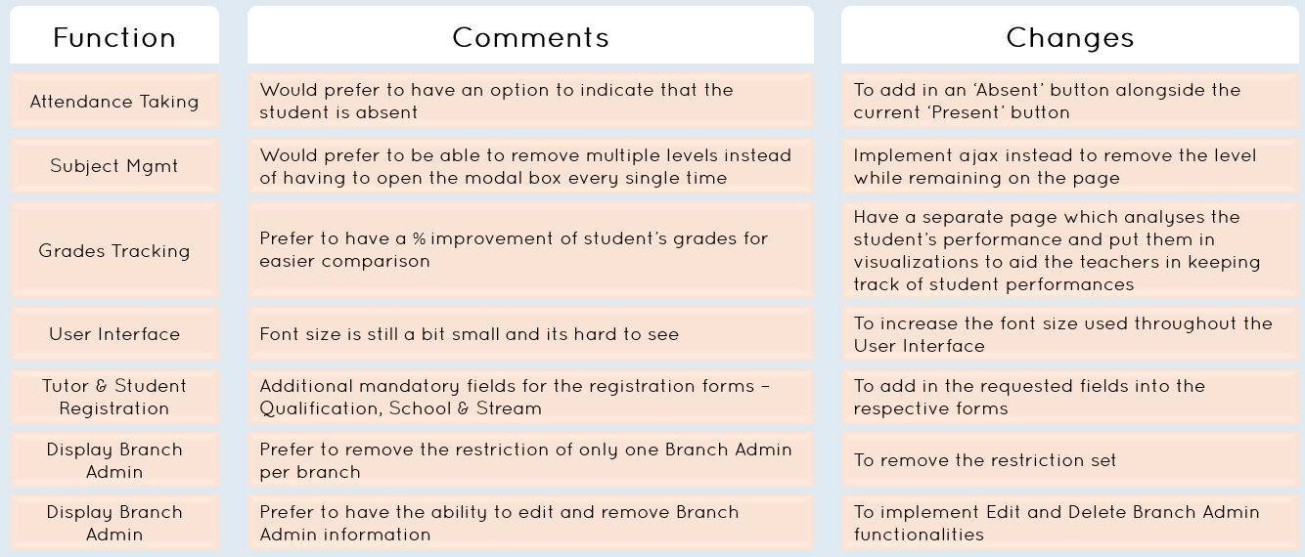
Overall Feedbacks

Slide 22
5.
Project Management

Slide 23
Acceptance
CORE
SECONDARY
TERTIARY
Accounts Module
Profile Mgmt
Login/Logout
Reset Password
Admin Module
Access Control
Admin Mgmt
Branch Mgmt
Subject Mgmt
Receipts Module
Pay Slip Generation
Invoice Generation
Rewards Module
Creation of reward points
Updating of reward points
Reading of reward points
Financial Module
Exporting
Updating
Writing
Viewing
Calculations
Dashboard Module
Summary of Financial
Report
Late Payments List
Replacement Classes List
Class Listing
Weekly Lesson Schedule
Number of Classes
Number of Branches
Number of Students
Number of Tutors
Schedule Module
Creation
Updating
Viewing
Grades Module
Grades Modification
Adding of Grades
Grades Viewing
Student Mgmt Module
Creation
View
Update
Delete
Mass Upload
Tutor Mgmt Module
Creation
View
Delete
Update
Mass Upload
Attendance Module
Creation of Tutor & Student Attendance
Reading of Tutor & Student Attendance
Updating of Tutor & Student Attendance
Search Module
Search Students
Search Tutors
Search Reports (By month, By year)
Payment Module
Tracking
SMS Reminders
Parent Mgmt Module
Creation
View
Update

Slide 24
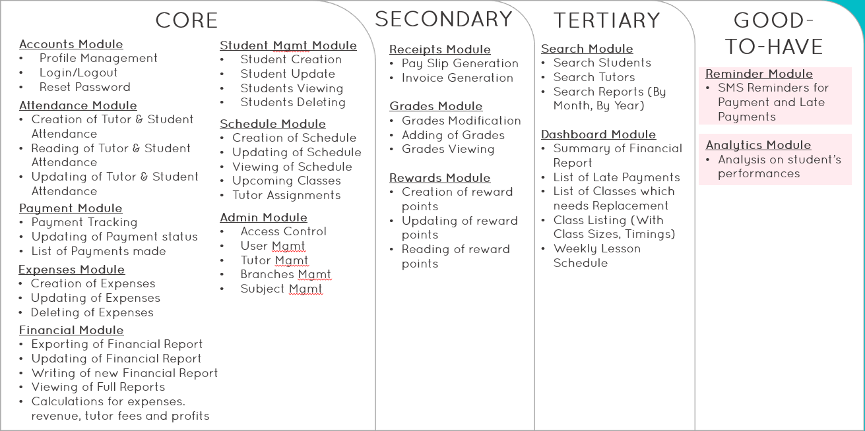
Since Acceptance

Slide 25
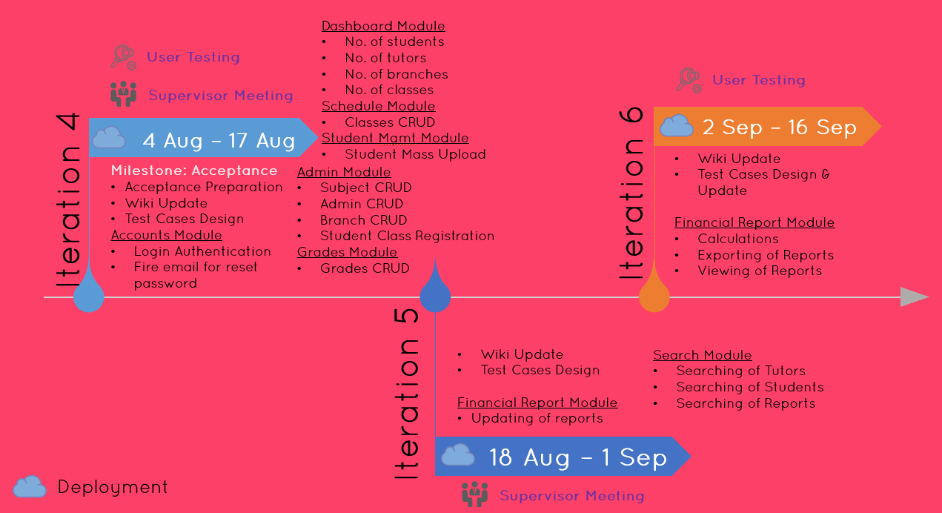
Acceptance

Slide 26
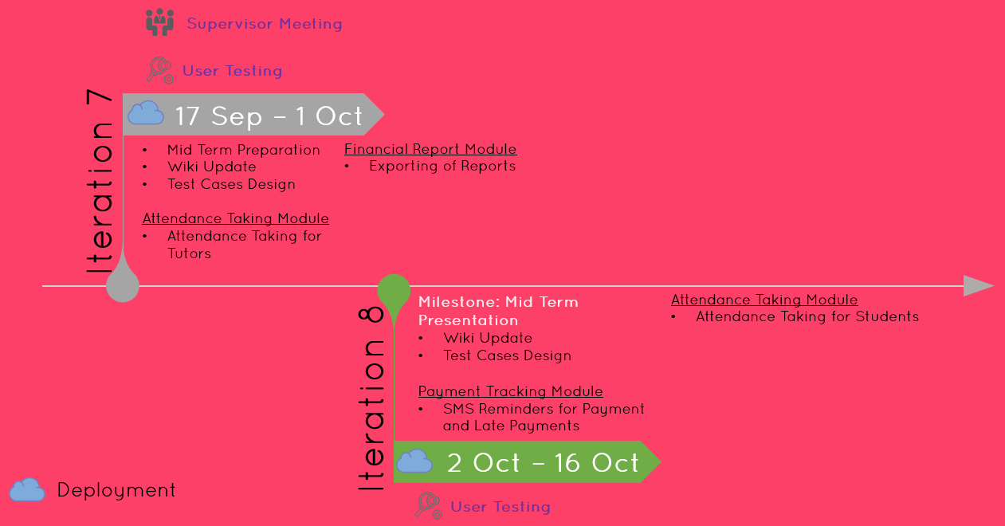
Acceptance

Slide 27
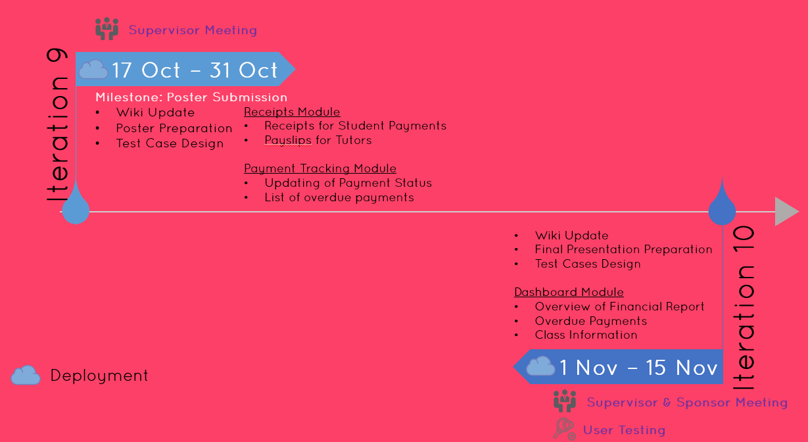
Acceptance

Slide 28
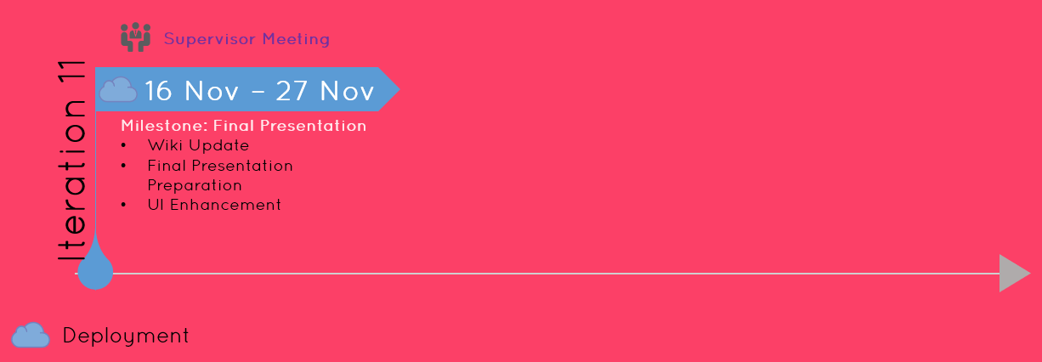
Acceptance

Slide 29
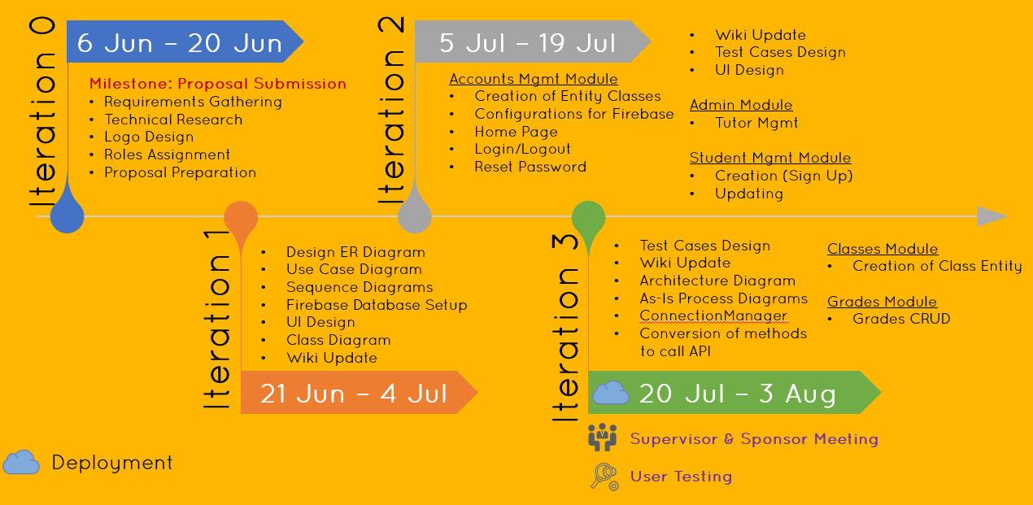
Since Acceptance

Slide 30
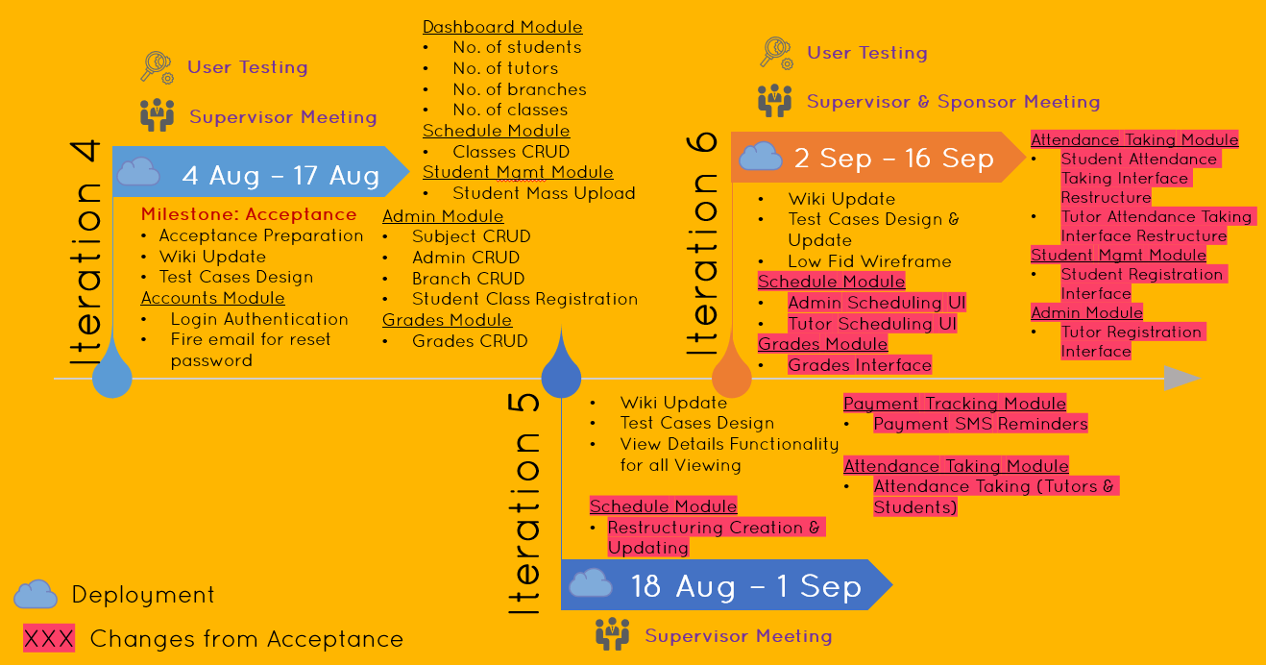
Since Acceptance

Slide 31
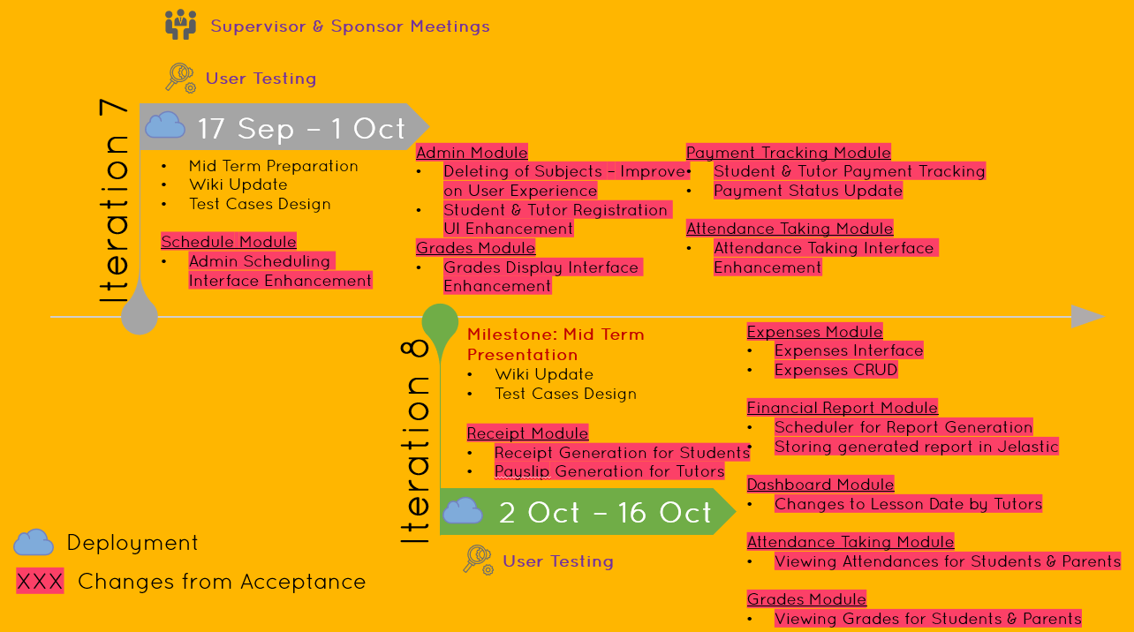
Since Acceptance

Slide 32
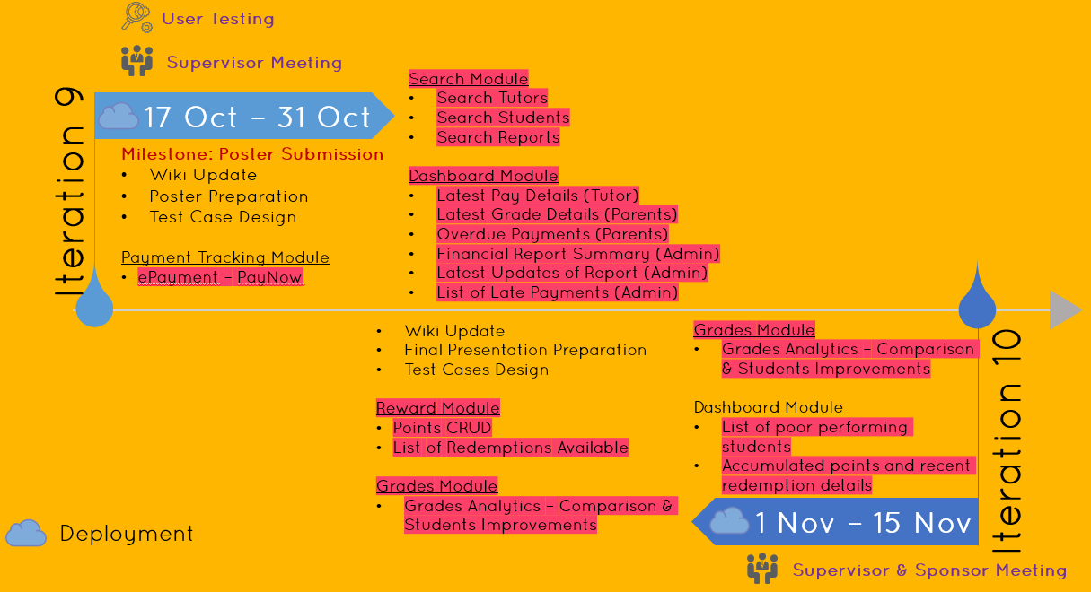
Since Acceptance

Slide 33
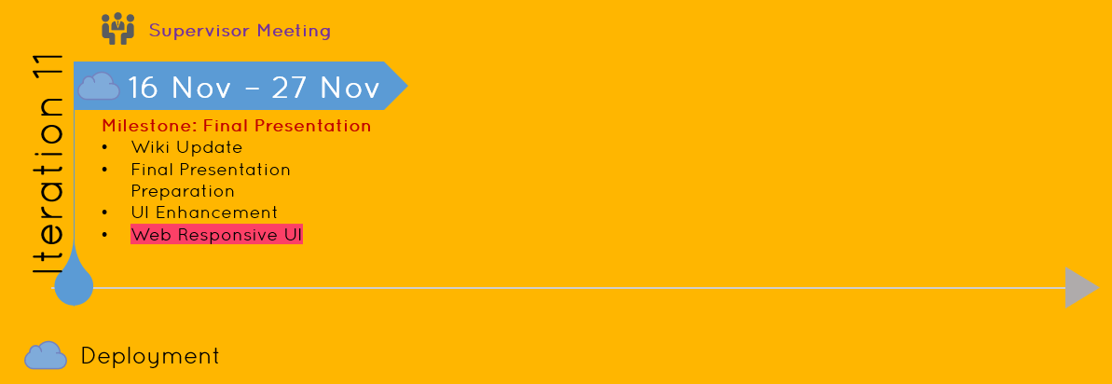
Since Acceptance

Slide 34
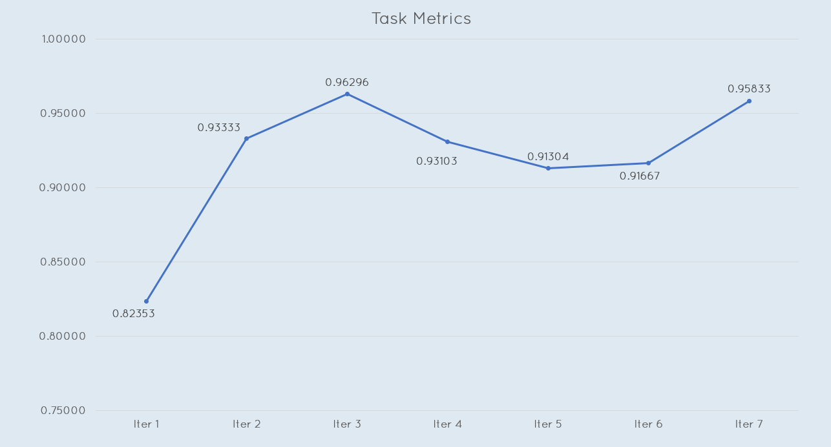
Task Metrics

Slide 35
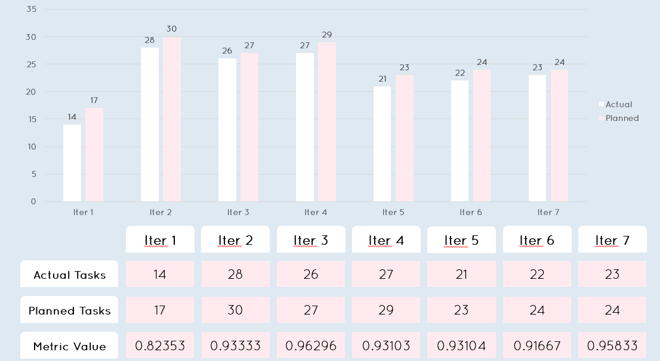
Task Metrics

Slide 36
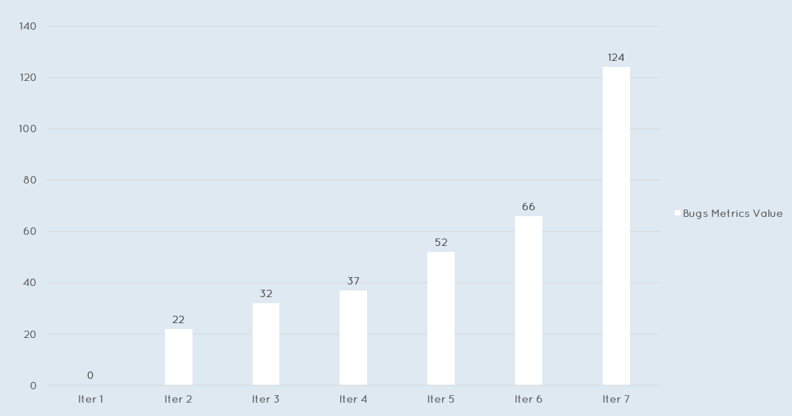
Bug Metrics

Slide 37
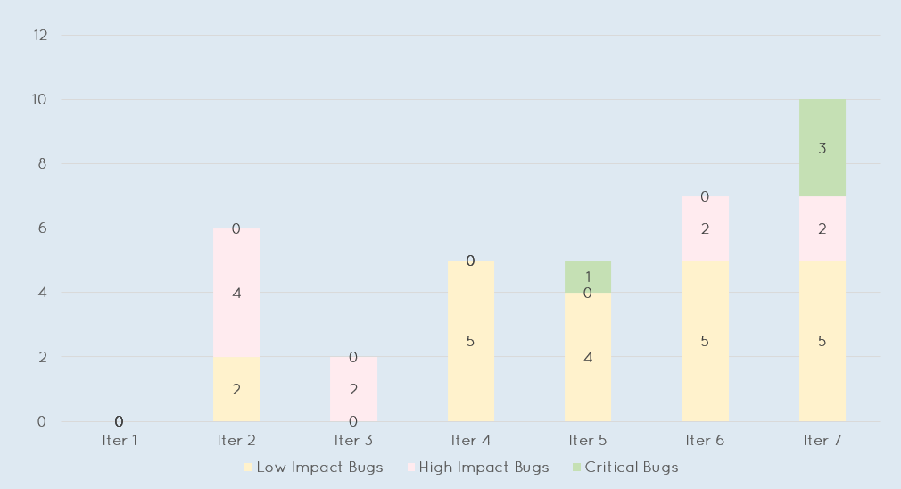
Bug Metrics

Slide 38
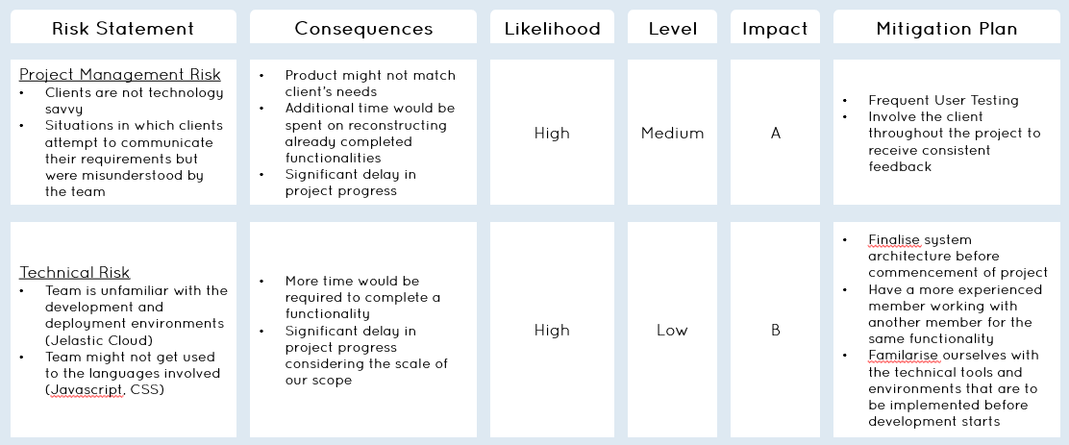
Risk Management

Slide 39
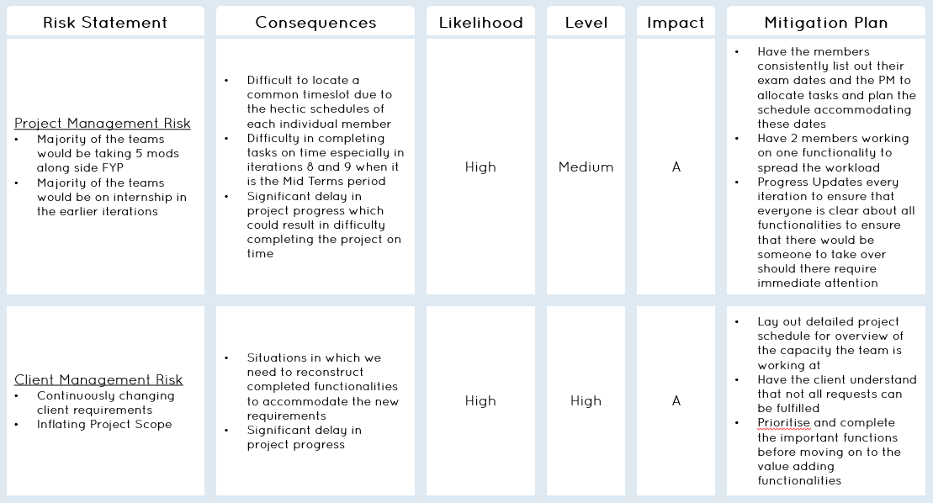
Risk Management

Slide 40
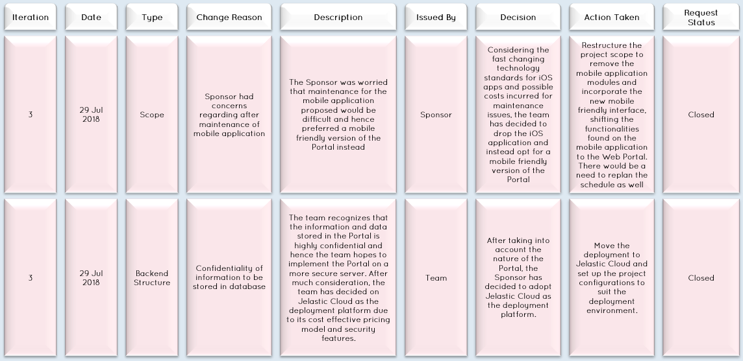
Change Management

Slide 41
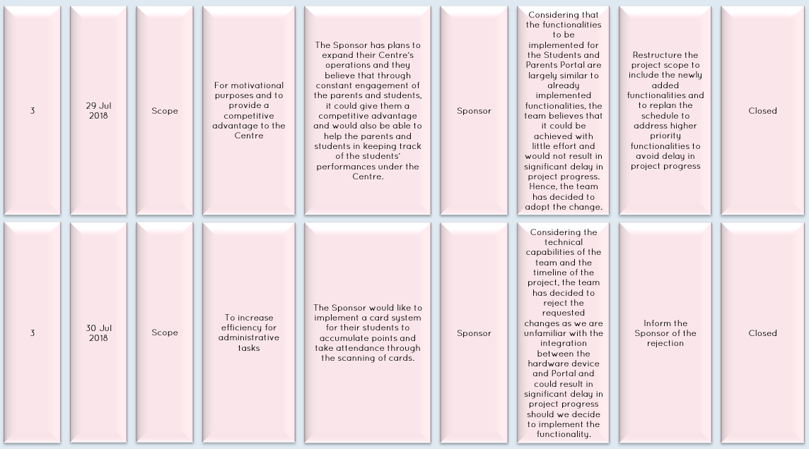
Change Management

Slide 42
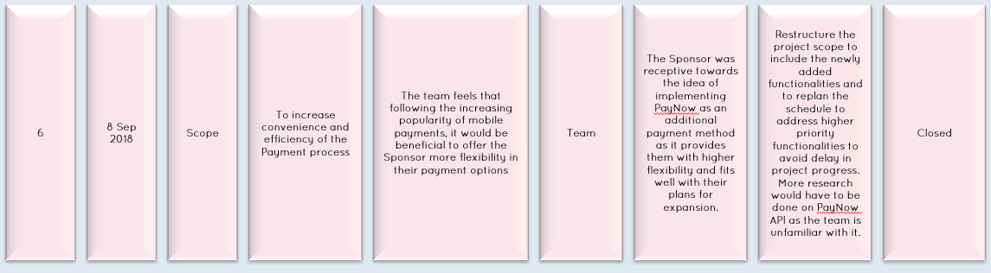
Change Management

Slide 43
6.
X Factor

Slide 44
X Factor
Mid Term
Conduct Pilot Testing with the Centre on 2 classes of 10 students and 1 tutor
Reduction in time taken to complete daily administrative tasks for an estimated of 30 – 40%%
Final

Slide 45

Pilot Testing
We managed to conduct Pilot Testing with the entire branch consisting of 3 branch admins, 4 tutors and 61 students!!!

Slide 46
7.
Pilot Testing

Slide 47
Overview
Participants
3 Branch Admins
4 Tutors
61 Students
17 Classes
Scope
Account Module
Admin Module
Student Mgmt Module
Grades Module
Attendance Taking Module
Scheduling Module

Slide 48
Feedbacks
Certain classes consists of students of varying levels (E.g Sec 3 and Sec 4 English classes are combined) but the scheduling functionality does not cater to this.
Unable to edit attendances once marked
Optional details could not be entered on registration. Instead, had to create the student then navigate to edit the student information
Restriction on mobile number for Student Registration does not take into account home number
Portal does not work well on Internet Explorer
Tutor Account Creation emails are sending out the wrong usernames

Slide 49
8.
Learning Outcomes

Slide 50
Hui Xin
As the Project Manager, I have realized the importance of planning ahead. In the earlier iterations, it was during Summer Break and hence there were not many issues with clashing schedules. However, as school starts and all of us taking different mods, it is getting increasingly difficult to arrange for meetings. In addition, with the workload of other mods and exams, more efforts are required for the delegating of work to ensure my members could balance FYP and other mods without compromising on either.
In addition, this is actually the first time I have participated in the Front End developing and I have learnt a lot, ranging from how to source and utilize libraries as well as how to design an interface that would best suit the needs of our clients.

Slide 51
Moh Moh
The project till now has gave me many knowledge on User Experiences which I had vague knowledge before. An example would be the issue of the page always refreshing upon the completion of a single action. When designing, I did not take that into account and upon testing and receiving feedbacks from the actual users, I actually learnt how to design with the users in mind.
In addition, I realise the importance of time management more as I progress further into the iterations as there is a need for proper time management so I could juggle my other mods together with FYP.

Slide 52
Riana
As a lead back-end developer, I would like to experience working with different role in a team and also with our client. Most importantly, I would like gain experience in understanding and implementing the system based on client's requirement so that we can deliver a solid system to our client.
Besides, as a member of the team, I hope to learn to work as a team, and gain knowledge from the rest of the team while I also share the knowledge I have.

Slide 53
Shawn
With 5 mods including fyp as well as two sports competitions has made me very pressed for time. However, it better taught me how to manage and plan my time. It has also taught me how to better work in a team, not to overpromise deadlines for example.
Through this project I have also improved my coding proficiency and expanded my knowledge on languages.

Slide 54
Thet Thet
As a Back End Developer, I work a lot with coding logic and technical implementations. Certain frameworks or libraries are foreign to me and I have to familarise myself with those technical tools in the shortest time possible due to our tight schedule. Hence, consistent learning throughout development and time management became my key takeaways from this project, aside from all the new technical knowledge.

Slide 55
Zang Yu
Time management was one of the most important takeaways from the project for me till date as I am juggling between 4 other mods and FYP. There is a need for me to be able to maintain my grades yet not compromise on my quality of work and quantity of contribution to the team.
In addition, this is my first time working as a Front End Developer and it has made me gain many insights on how to design a clean interface which would be comfortable to the users and how to design with the users in mind.

Slide 56
Thank you!

